Slide 1
Sports Info Solutions D-Line Analytics Challenge
By Emmett Kiernan
Northeastern University Economics M.S. Recent Graduate
Former Subpar D-III Defensive Lineman

Slide 2
Initial Data Adjustments
Filter out Spikes and QB Kneels
Remove QB scrambles from run analysis
Remove players not listed as DL or LB, as well as those who rushed on fewer than 50% of passing snaps
Add a column for standardized player value. Uses OverTheCap pick value from Lee Sharpe’s GitHub for drafted players still on rookie contract and SpotTrac’s 2019 average salary data for all others. A value of 1.0 equates to one standard deviation greater than the mean salary/draft value for all players in the sample across all positions.

Slide 3
Position Definitions:
The SIS data helps clarify vague roster positions which don’t always translate between schemes. I divided players into three position groups using K-Means Clustering on player alignment data: Edge (LBs and pass-rushing DEs), Tackle (mostly 3-4 DEs and pass-rushing DTs), Nose (mostly 3-4 NTs and run-stuffing DTs). This allows for an easy comparison between schemes, as outside linebackers in 3-4 defenses hold similar responsibilities to defensive ends in 4-3 schemes. See the table below for some examples of which players fall under each cluster.
Edge Snap Leaders: | Tackle Snap Leaders: | Nose Snap Leaders:
Jason Pierre-Paul, TB (493) | Cam Heyward, PIT (474) | Kenny Clark, GB (410)
Chandler Jones, AZ (492) | DeForest Buckner, SF (461) | Javon Hargrave, PIT (410)
Bud Dupree, PIT (476) | Ndamukong Suh, TB (455) | Vita Vea, TB (406)
Khalil Mack, CHI (467) | Christian Wilkins, MIA (412) | Larry Ogunjobi, CLE (377)
Nick Bosa, SF (466) | Aaron Donald, LA (411) | Davon Godchaux, MIA (370)

Slide 4
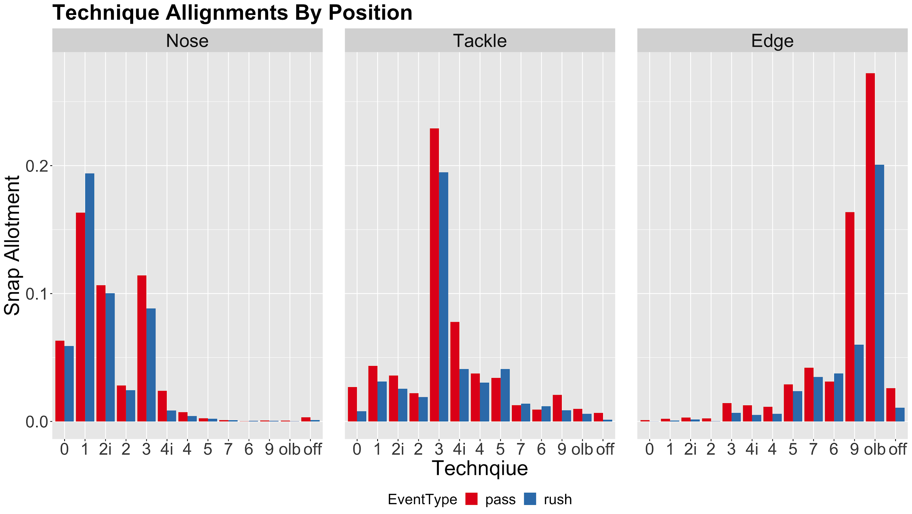

Slide 5
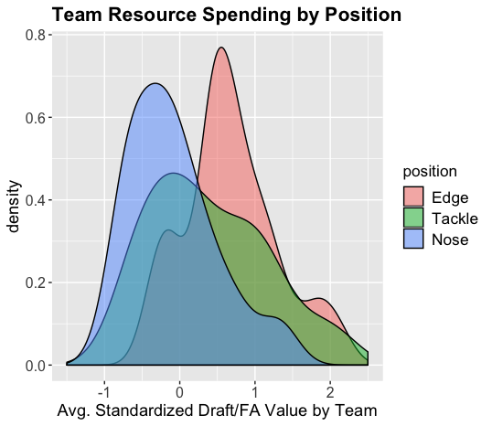
Resource Distribution
On average, teams dedicate the most salary/draft resources towards Edge players.
Tackle has the widest dispersion amongst teams.
This gives us a solid prior for positional value.
Note: Average position resources spent is measured on a per player-snap basis, so more Edges being on the field or on a roster does not impact the results.

Slide 6
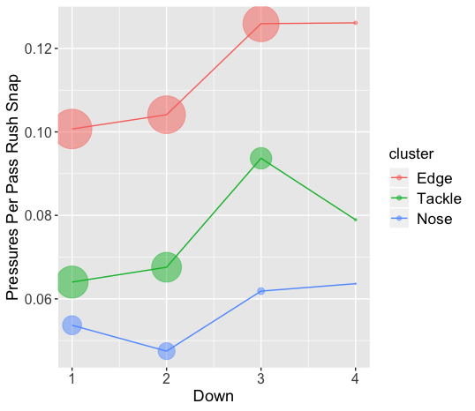
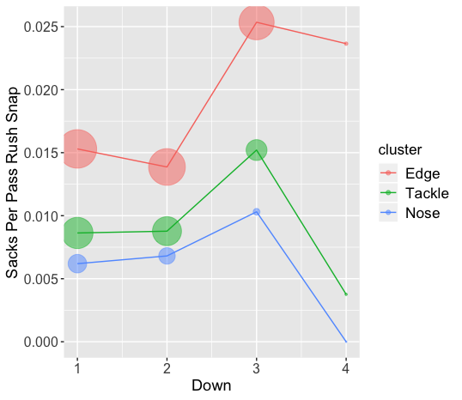
Pressure and Sack Rates By Position

Slide 7
Pass Rush Model: Intro
Logit mixed effects model to evaluate pass rush ability
Only passing plays where the player is rushing are included
Formula: Pressure = as.factor(Down) + Distance + Technique + (1 | Player)
The partial pooling component of mixed effects models allows for more accurate comparisons between players with different sample sizes.
I am using pressures and not sacks, as a higher frequency event is more applicable to an eight week sample. Timo Riske (Pro Football Focus) has also shown that turning pressures into sacks is not a repeatable skill.
Air yards are not controlled for, due to potential reverse causality.

Slide 8
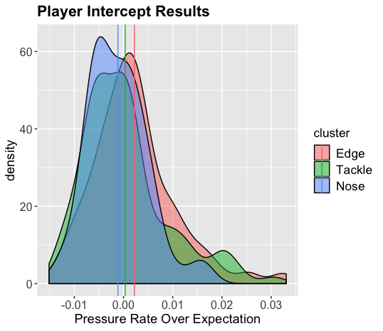
Pass Rush Model: Position Distribution
The player intercepts are converted to Pressures Over Expectation via the odds ratio.
We can see here that while all three distributions are similar, Edge has a slightly higher mean value.
Edge pressures also have the greatest impact on EPA and success rates for the offense.

Slide 9
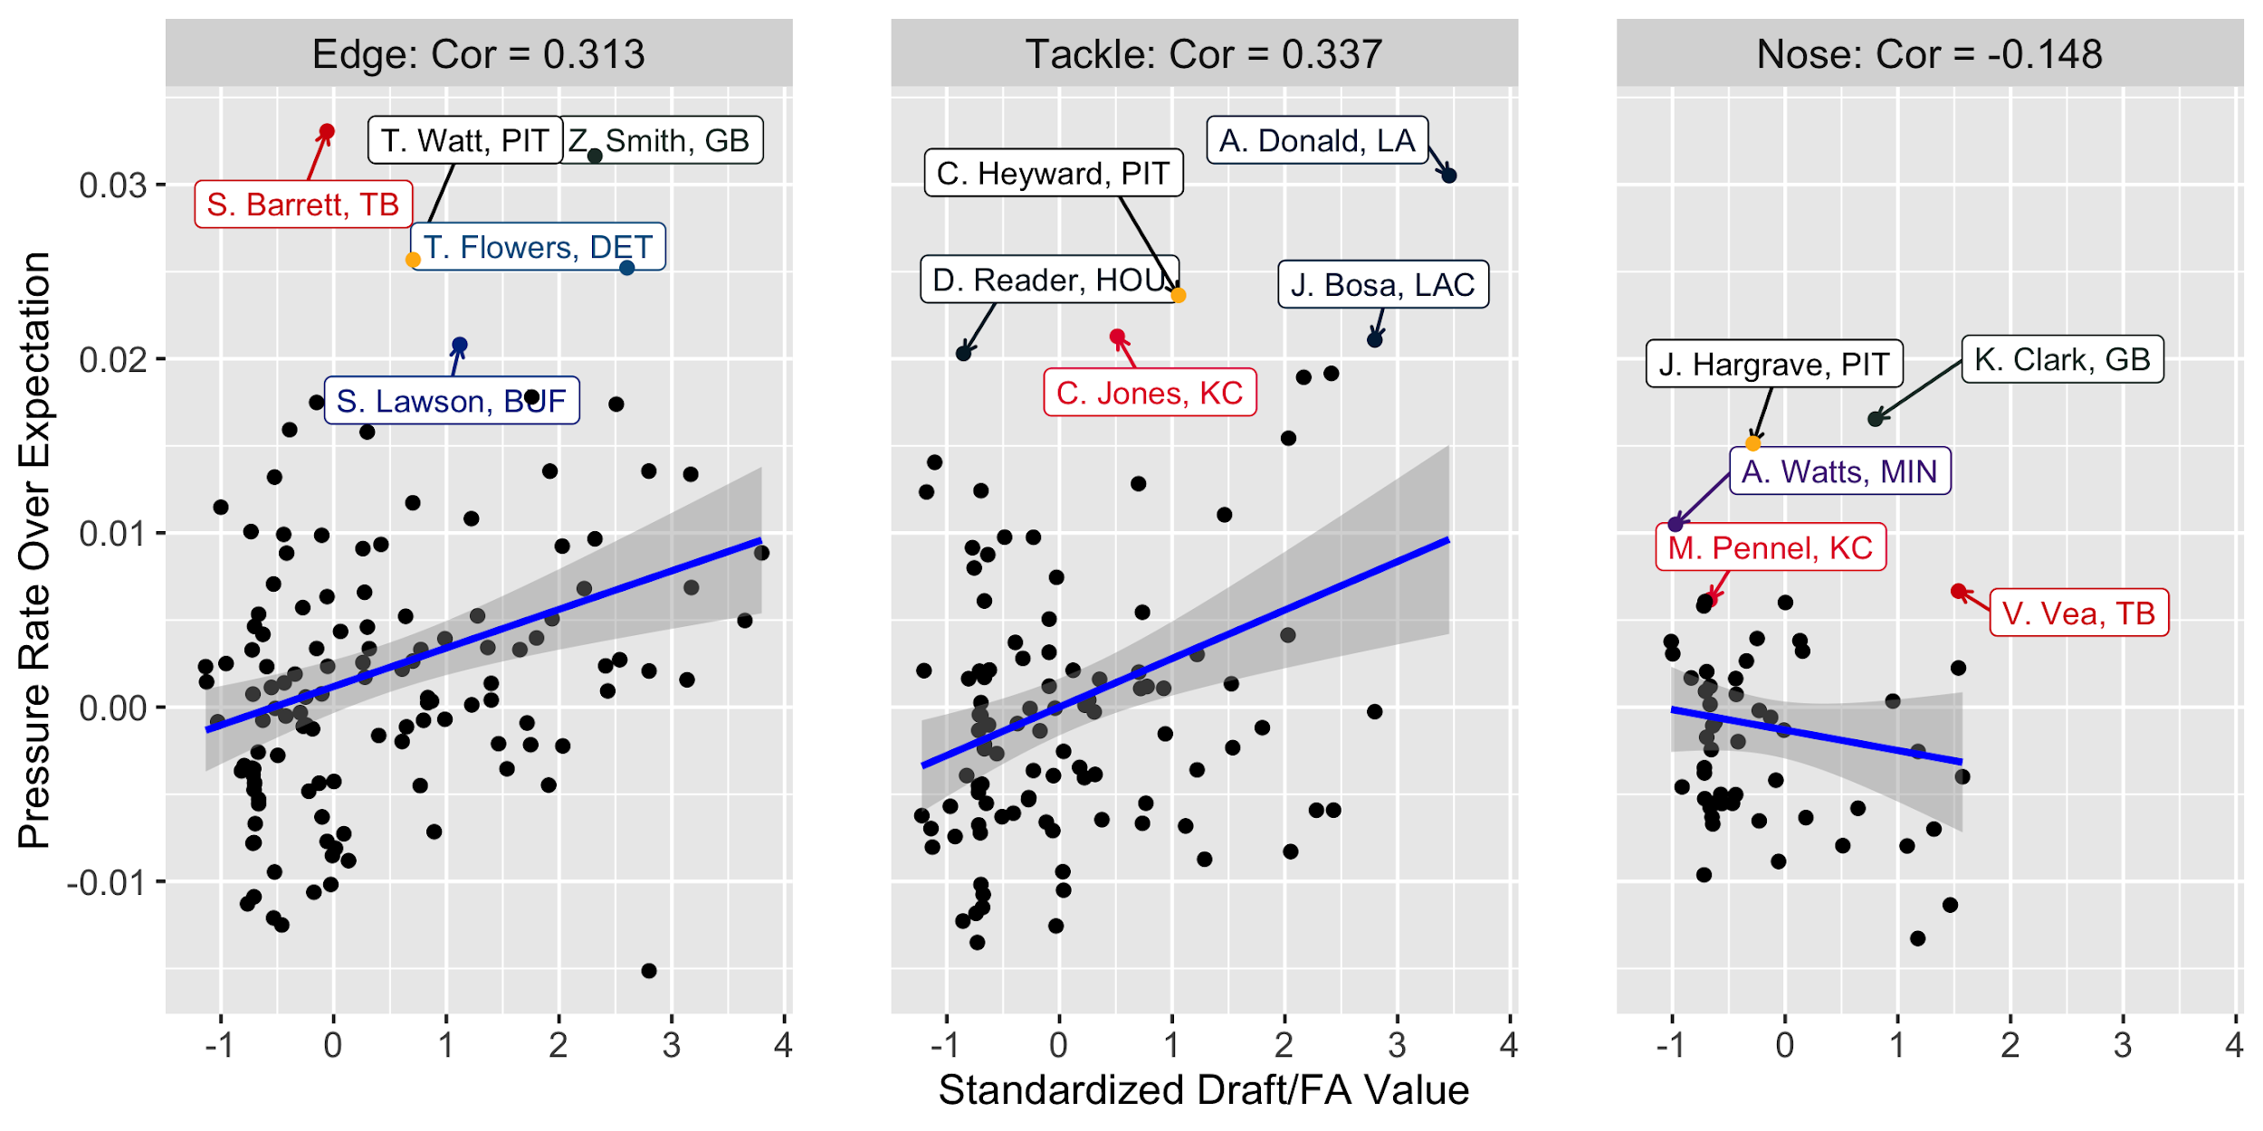
Pass Rush Model: Return On Investment

Slide 10
Pass Rush Model: Conclusions
While controlling for alignment and situation, the distribution between all three positions is similar. Edge and Tackle produce similar returns on investment when it comes to pressures. However, Edge pressures occur on a higher percentage of snaps, have a greater impact on the play result, and the position receives the most pass-rushing snaps. For those reasons, I can confidently conclude that Edge is the most valuable defensive line position for rushing the passer.
All of the above reasons also hold true as to why Tackle is more valuable to pass rush than Nose, other than pressure’s effect on play outcome. Additionally, the difference in return on investment between the two positions widens the gap even further.

Slide 11
Pass Rush Model: Assumptions and Limitations
The biggest limitations are not knowing the talent of the offensive lineman blocking each player, which players are being double-teamed, or the impact coverage had on creating the pressure. This could be improved with O-line snap data and/or tracking data.
While I do believe focusing on pressures more than sacks is the correct decision in any sample due to the latter being a rare event, with more weeks of data I certainly would have paid more attention to them. It is reassuring to see that even with just eight weeks of data, the two metrics follow the same patterns when comparing rates by down and position.
The partial pooling element in accessing the player intercepts is extremely valuable for dealing with players of different sample sizes. One future improvement would be using priors to regress players to different means. For example, Myles Garrett likely deserves to be punished less for his small sample size than a player without the same draft capital and past production.

Slide 12
Run Defense Models
Since separating individual and team run defense is so difficult, I am not going to attempt an omniscient metric that tries to put one number on a player’s ability to stop the run.
Instead, I fit three different models to examine more specialized metrics which can be used to supplement existing evaluation methods such as team-stats, film, PFF grades, or insights from tracking data:
Negative EPA Tackle Rate
Adjusted Success Rate (on run plays toward the player’s side)
Gap Changes Forced

Slide 13
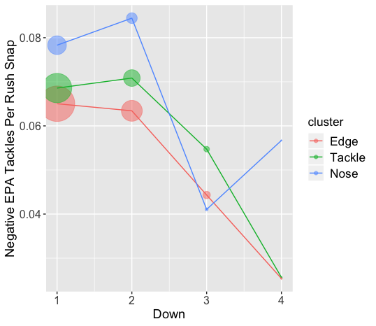
Negative EPA Tackles: By Position
Noses make negative EPA tackles at the highest rate on all downs but third.
The sample sizes are much larger on the early downs, as indicated by the size of the points.

Slide 14
Negative EPA Tackles: Model
Mixed Effects Ordinal Logit Model
Filter for only run plays
RunSide is a binary variable for if the run was toward the player’s side
Ordinal model is appropriate since the response variable can only take values of 0, .5, or 1
Formula: Negative EPA Tackles = as.factor(Down) + ToGo + RunGap + RunSide + Technique + (1 | Player)

Slide 15
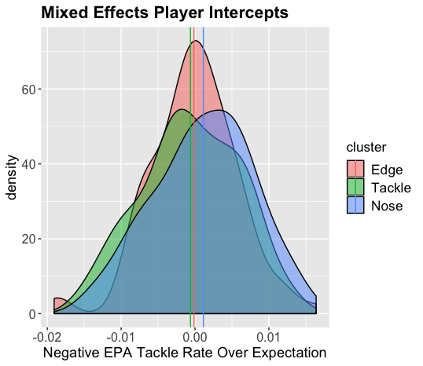
Negative EPA Tackles: Distribution
While controlling for situation and technique, Noses have the highest mean and the fattest tail. This shows that they still produce more Negative EPA Tackles than the other positions, even with control variables in place. We will see on the next slide, however, that Tackles produce more return on investment with this metric.

Slide 16
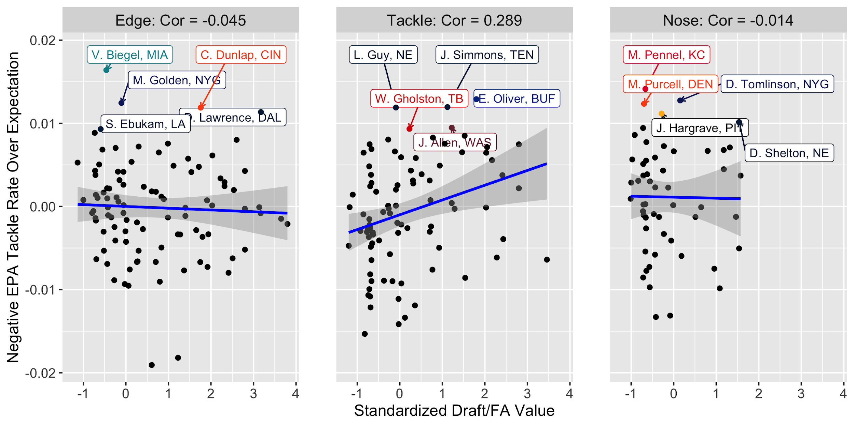
Negative EPA Tackles: Return On Investment

Slide 17
Rushing Success Rate: Model
Mixed Effects Logit Model
Fitler for rushing plays toward the direction where the defensive player lined up, unless they are in a 0 Technique.
Offensive team is being controlled for.
Formula: Success = as.factor(Down) + ToGo + RunGap + (1|Offensive Team) + (1|Name)

Slide 18
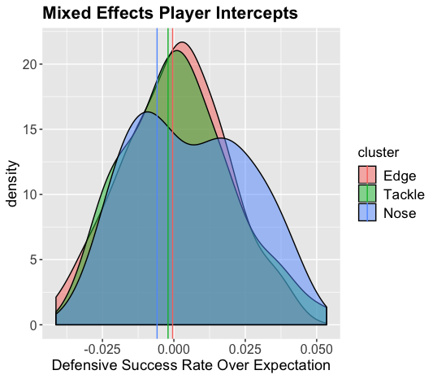
Rushing Success Rate: Distribution
Further evidence toward Nose having the widest distribution for run stuffing ability.
While the left side of the distributions are similar, Nose has the most high impact players for this metric.
Best scores lead to ~5% lower success rate
Limitations with team vs player credit

Slide 19
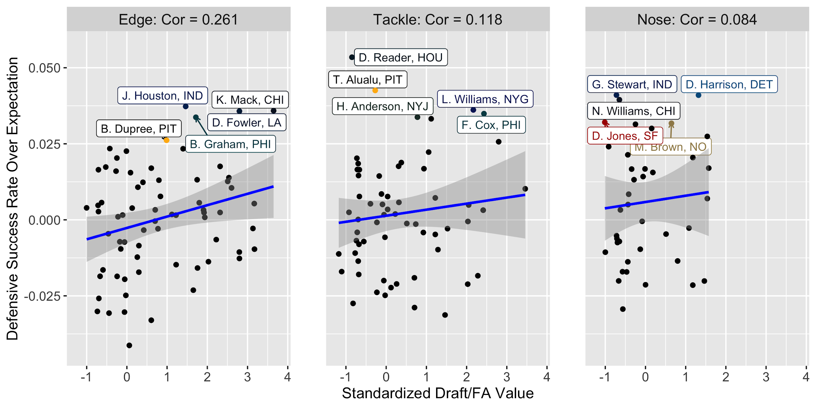
Rushing Success Model: Return on Investment

Slide 20
Gap Changes Forced: Model
Non Designated Gap runs have a lower success rate (.395 vs .450)
Mixed Effects Logit Model
Credited with contributing to the gap change if the run is toward the defensive player’s side
Fitler for rushing plays toward the direction where the defensive player lined up, unless they are in a 0 Technique
Formula: Used Designated Gap = RunGap + (1 | Player)

Slide 21
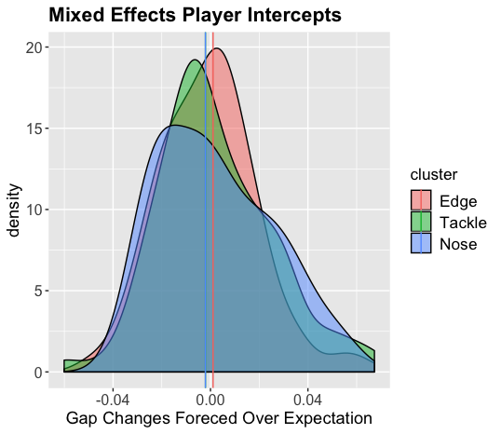
Gap Changes Forced: Distribution
More evidence suggesting Nose has the widest distribution for run stuffing ability
The best performers force a gap change 6-7% more often than expected

Slide 22
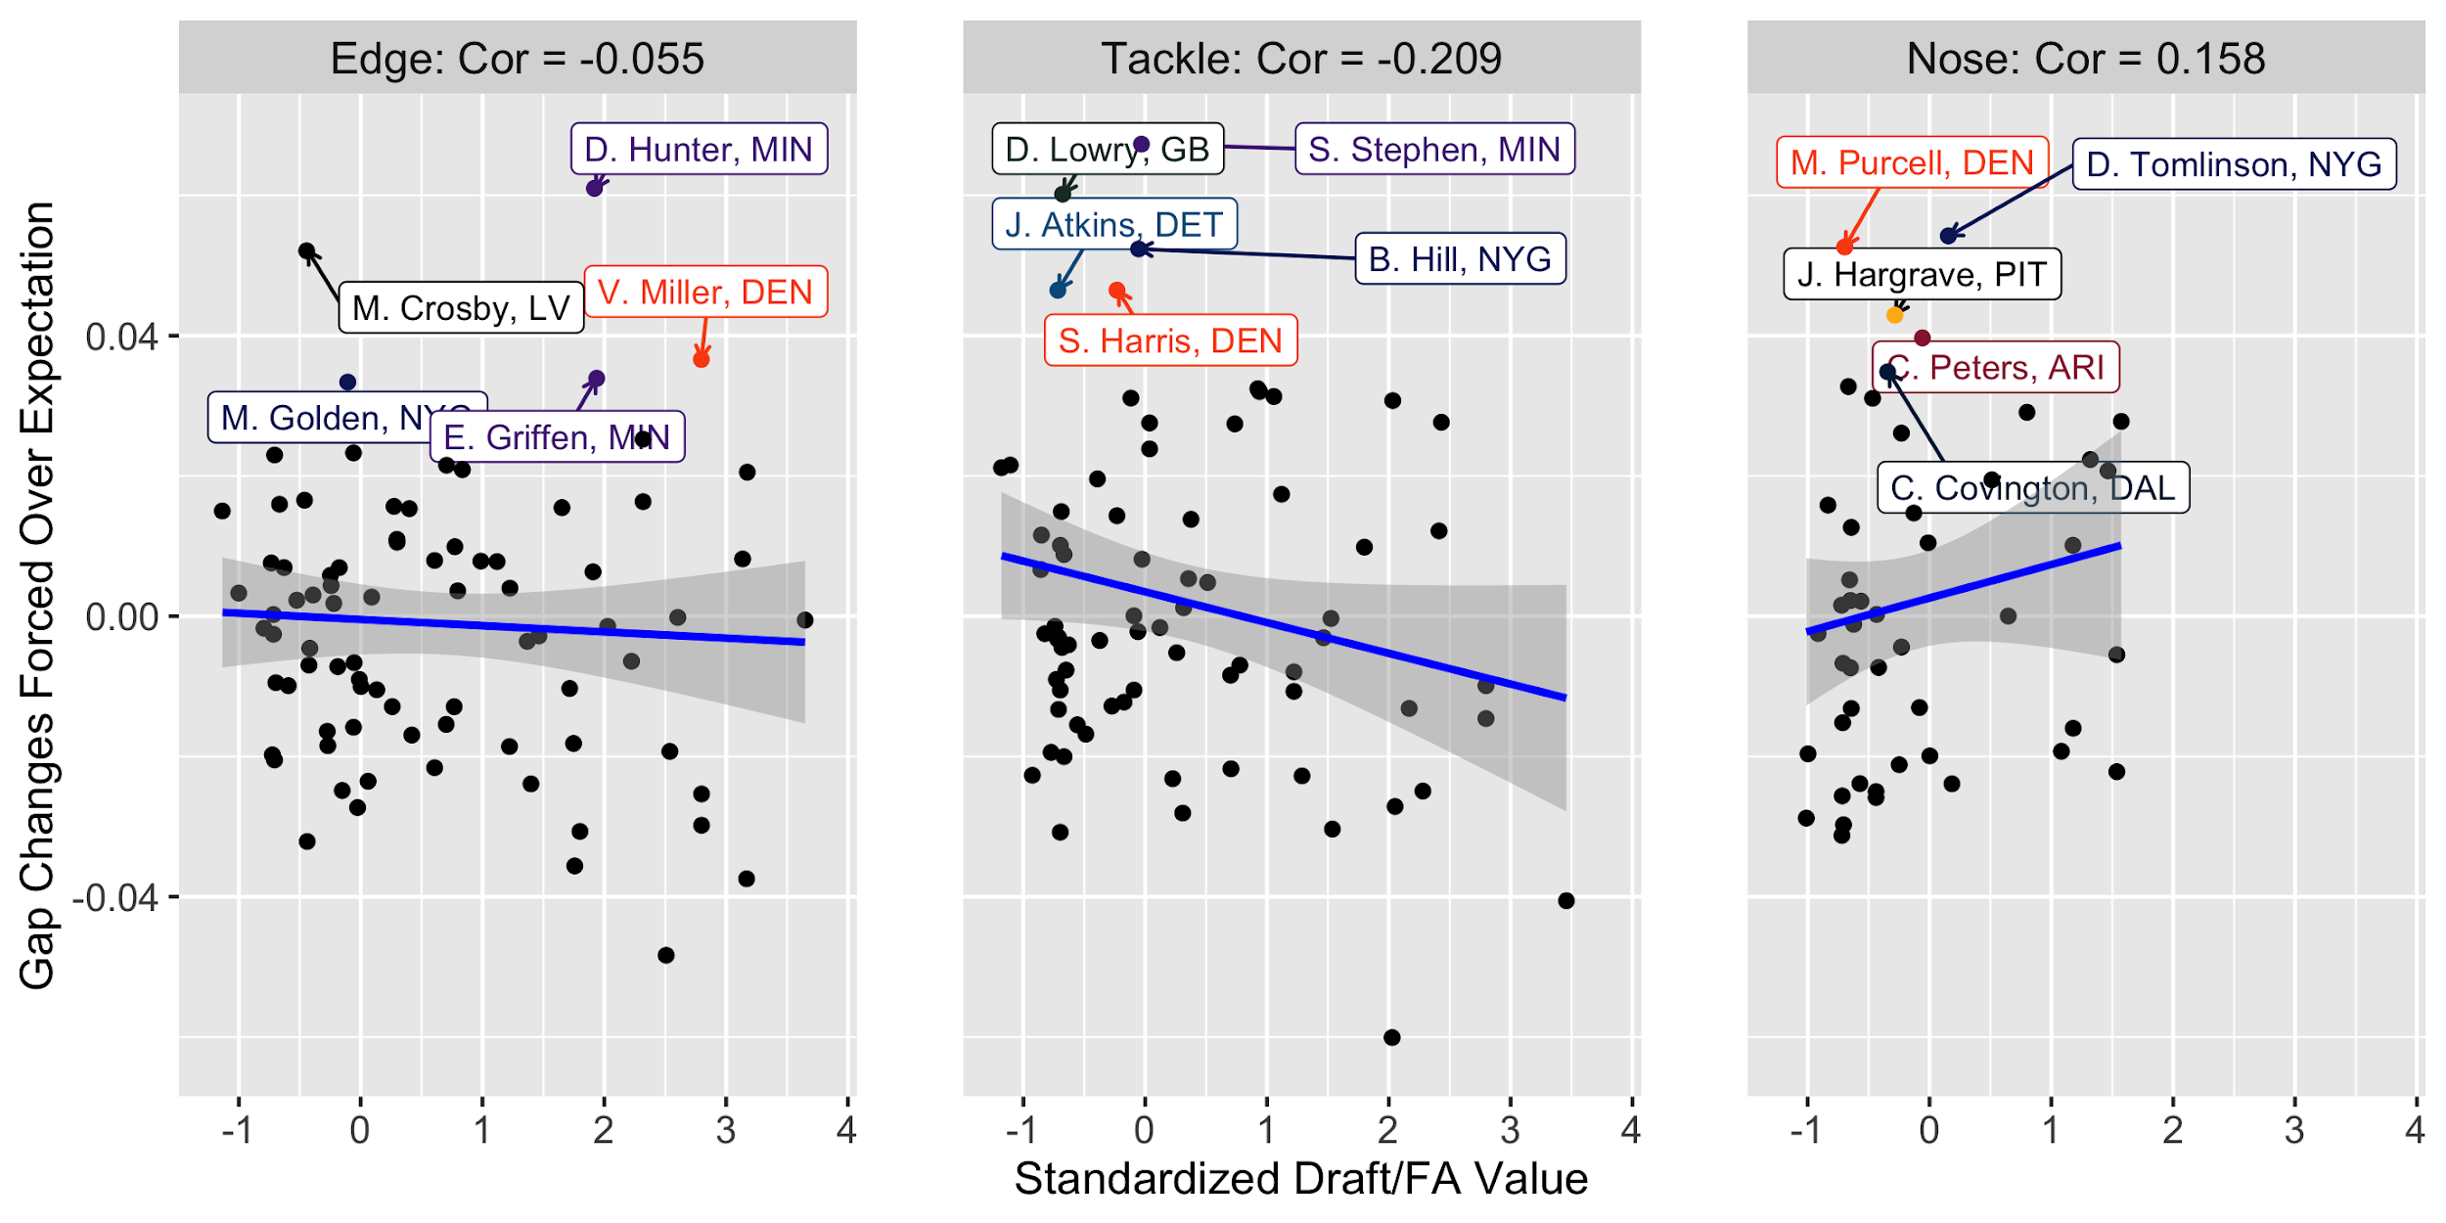
Gap Changes Forced: Return on Investment

Slide 23
Rush Defense Conclusions and Future Analysis
Noses appears to have the most value against the run. They create negative EPA tackles at the highest rate and also have the fattest tails for all three models. Return on investment seems to be quite random and mostly attributed to noise.
Unfortunately, the correlation between all combinations of the three metrics is weak, which suggests that they only paint a small portion of the picture when it comes to run defense skill.
With more seasons worth of data, calculating year to year stability would help further understand which metrics are more effective, as would correlation with Pro Football Focus grades, or some other subjective measure of run defense.
Access to tracking data would allow for more accurate separation between team vs individual performance against the run.

Slide 24
Final Conclusions
What is the most important defensive position? Edge is the most valuable defensive position. It’s a passing league and Edge is clearly the most important position when it comes to pressuring the passer. While Nose appears to have the greatest impact on defending the run, I consider Tackle the second most valuable overall, as the position’s return on investment for pass-rush is so much greater than the ROI for Noses in the run-game.
What is the nature of the distribution of talent between the defensive line positions? When controlling for both game situation and technique, Nose has the widest distribution in all four metrics studied. This would not be recognized with traditional defensive statistics. Edge and Tackle have quite similar distributions across the board.
In which in-game or roster construction scenarios would the answer to Question 1 change? Tackles cost less than Edges, so if a team did not have the resources to get a premier Edge, finding a quality Tackle could be the next best option. In a situation where a team needed to prioritize stopping the run, Nose could become the most important. However, analytics almost always want an opponent to pass less often.

